Slide 1
IPL VISUALISATION ASSIGNMENT
SUBMITTED BY: AKSHADA JOSHI

Slide 2
CONTENTS
Objectives
Problem Statement
Match Statistics
Player Statistics
Team Statistics
Summary

Slide 3
OBJECTIVE
To create an interactive dashboard that highlights some of the important statistics of the IPL over the year 2008-2017.

Slide 4
PROBLEM STATEMENT
As a data Analyst at IFP, a nationally recognized news agency, the sports editor of the agency has approached to build an interactive Tableau Dashboard of IPL statistics over the years since its inception in order to create an infographic for a newsletter that their team is working on.
For this newsletter, in some cases, they will use the visual representations you have created in Tableau directly for their infographic, and in a few other cases, they will use important statistics after trying out the different filters and customizations that you have provided for interactivity.

Slide 5
MATCH STATISTICS

Slide 6
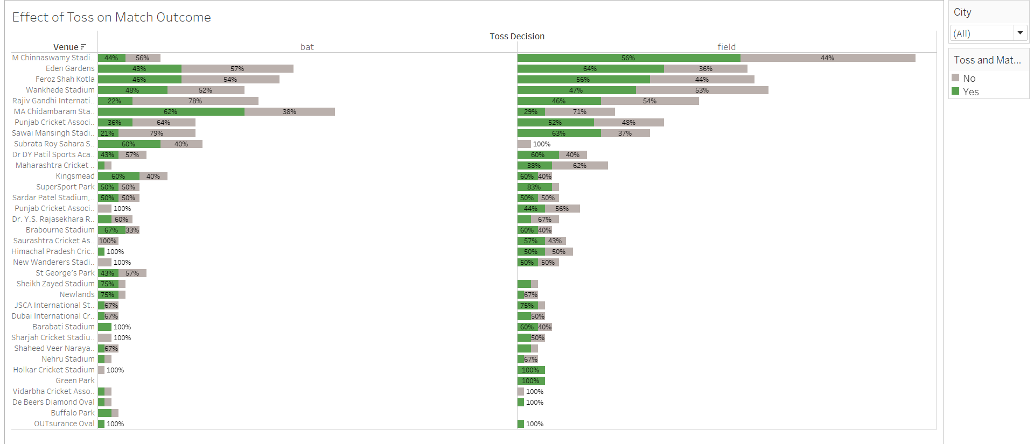
EFFECT OF TOSS ON MATCH

Slide 7
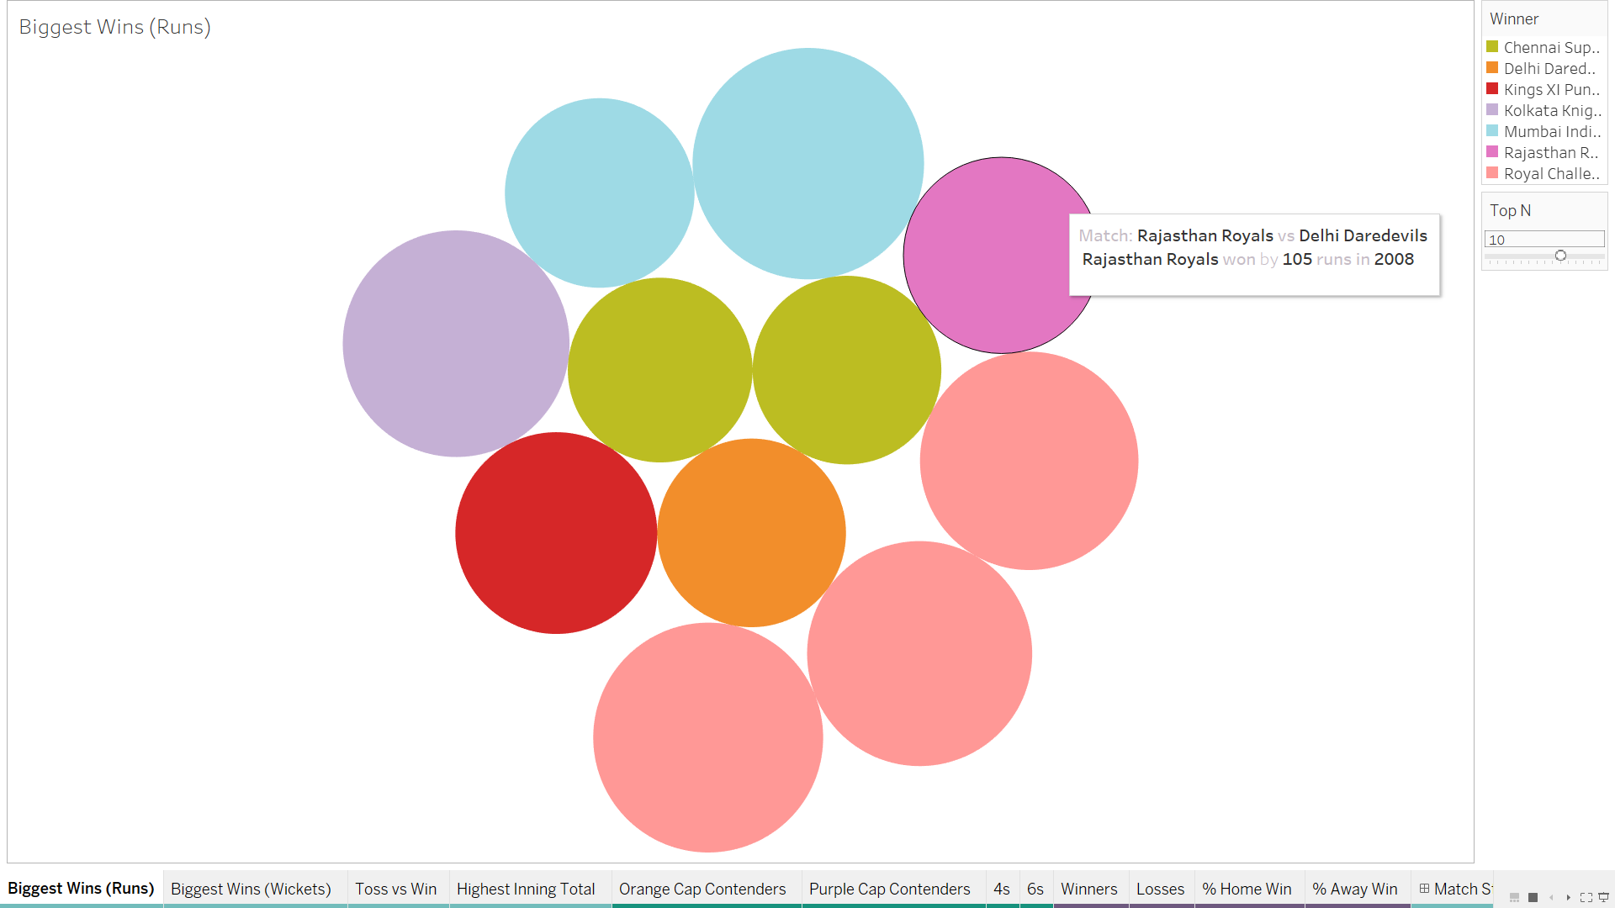
BIGGEST WINS BY RUNS

Slide 8
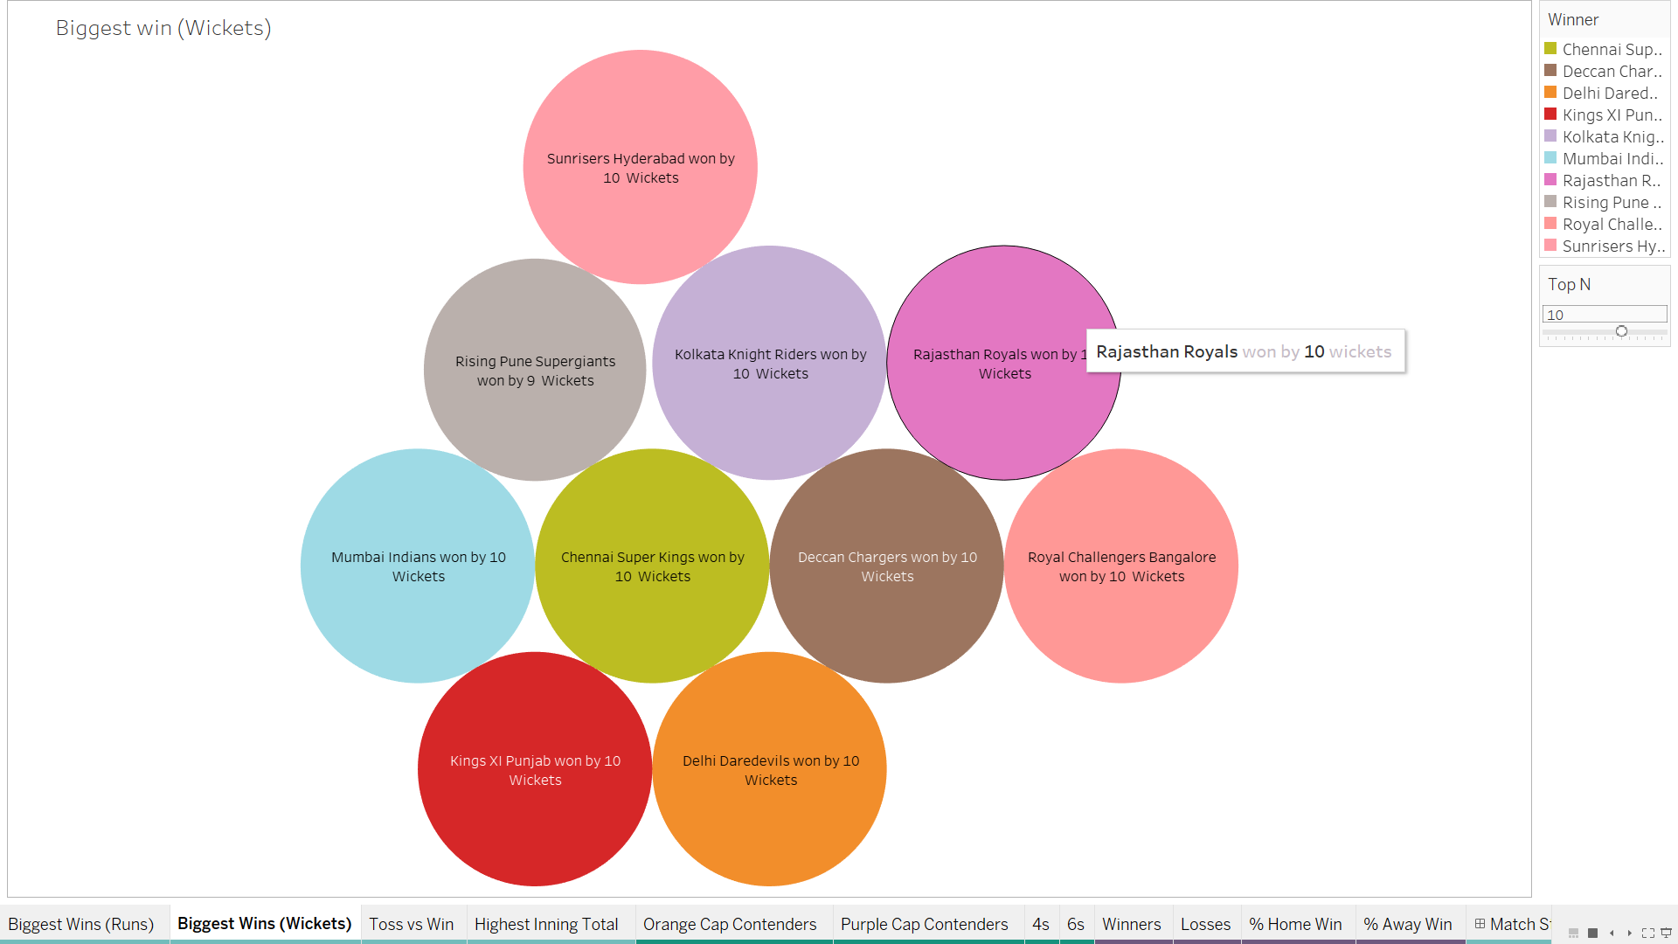
Biggest wins by Wickets

Slide 9
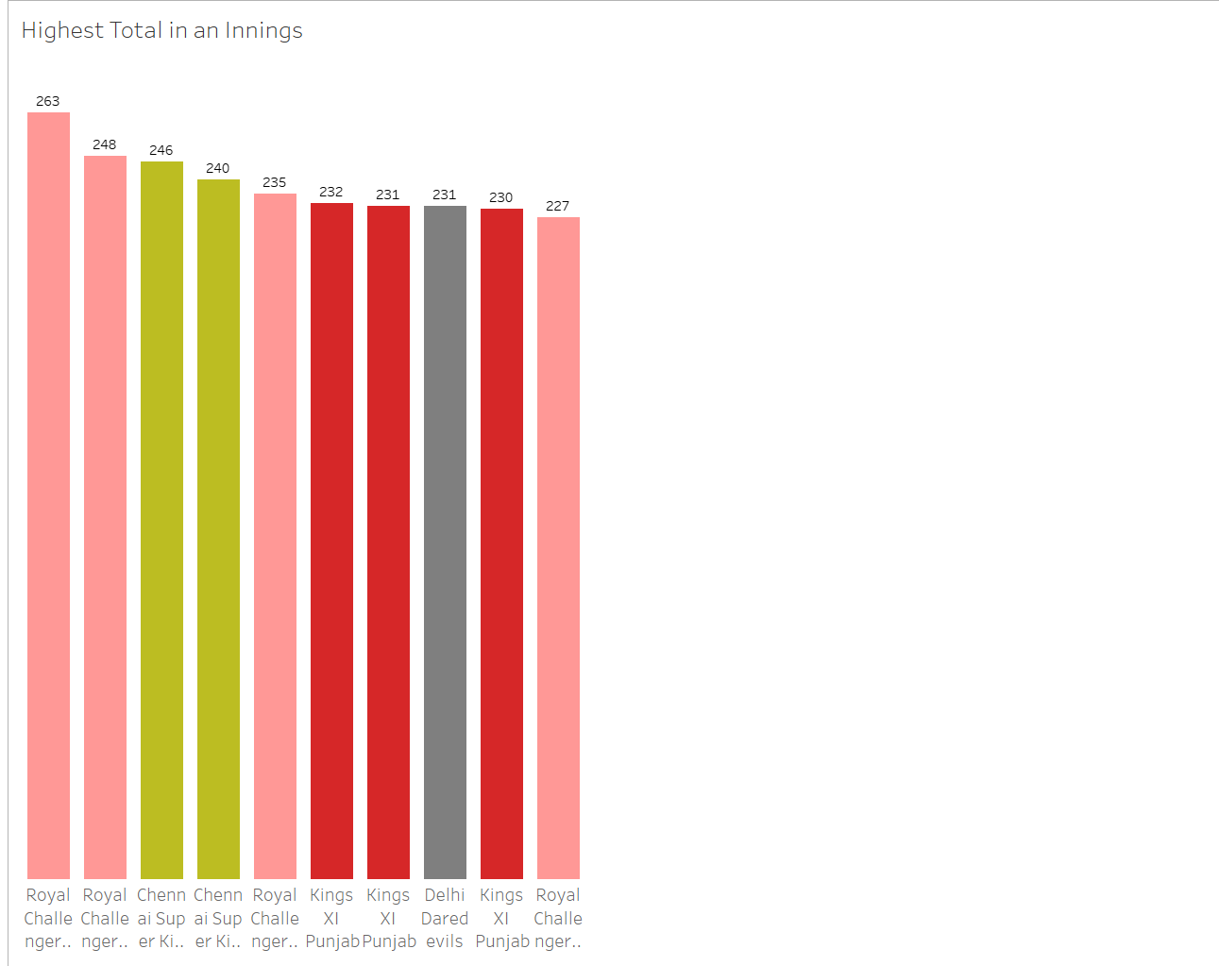
Highest Total in an Innings

Slide 10
PLAYER STATISTICS

Slide 11
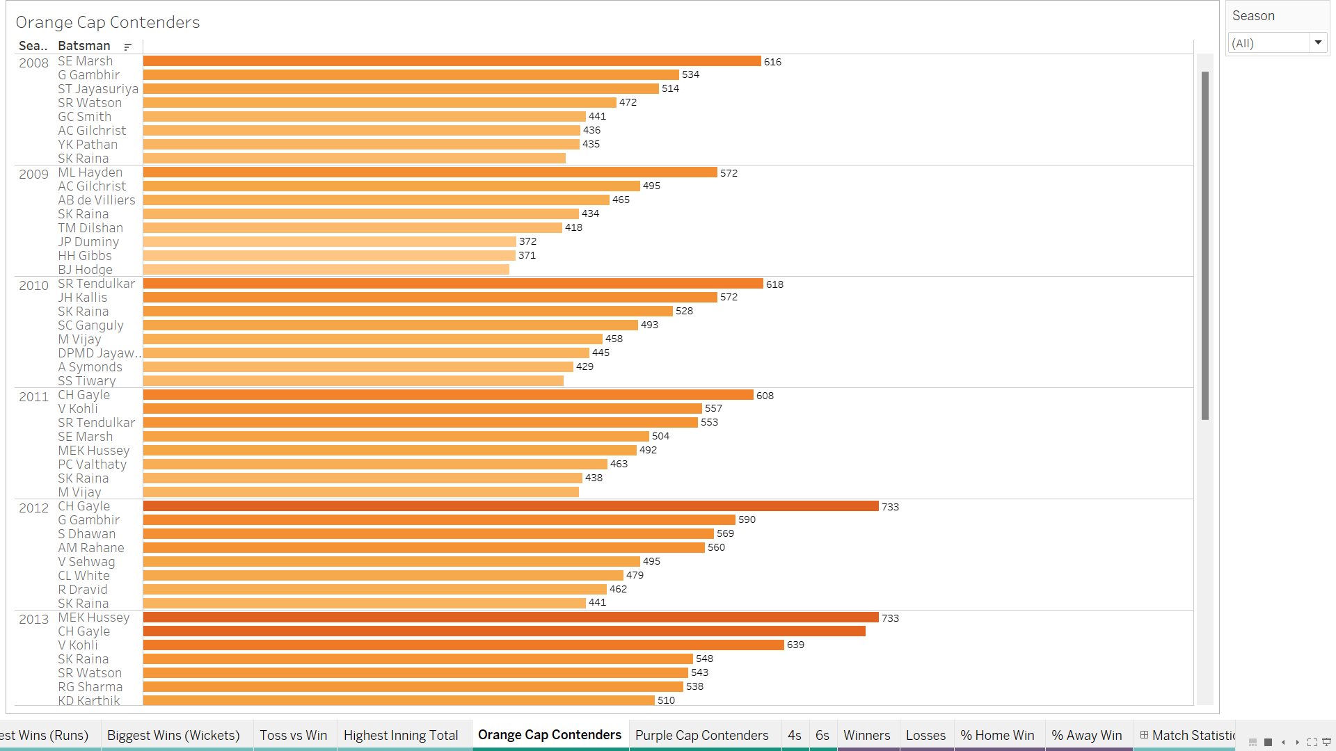
ORANGE CAP CONTENDERS

Slide 12
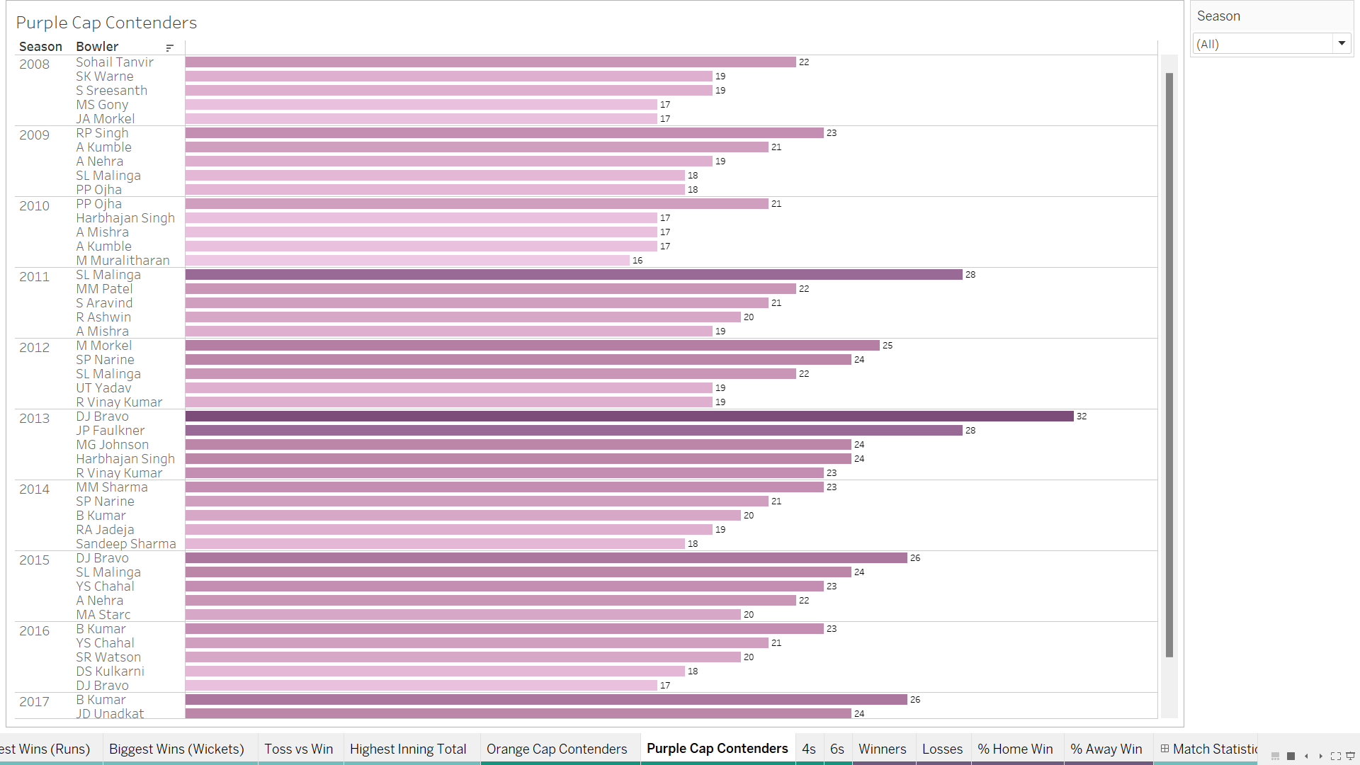
PURPLE CAP CONTENDERS

Slide 13
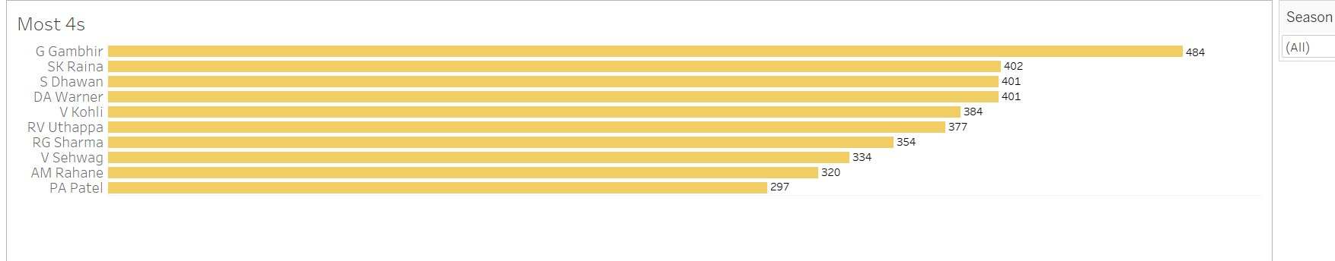
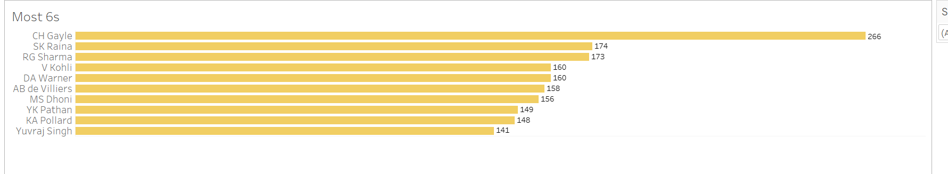
FOURS AND SIXES

Slide 14
TEAM STATISTICS

Slide 15
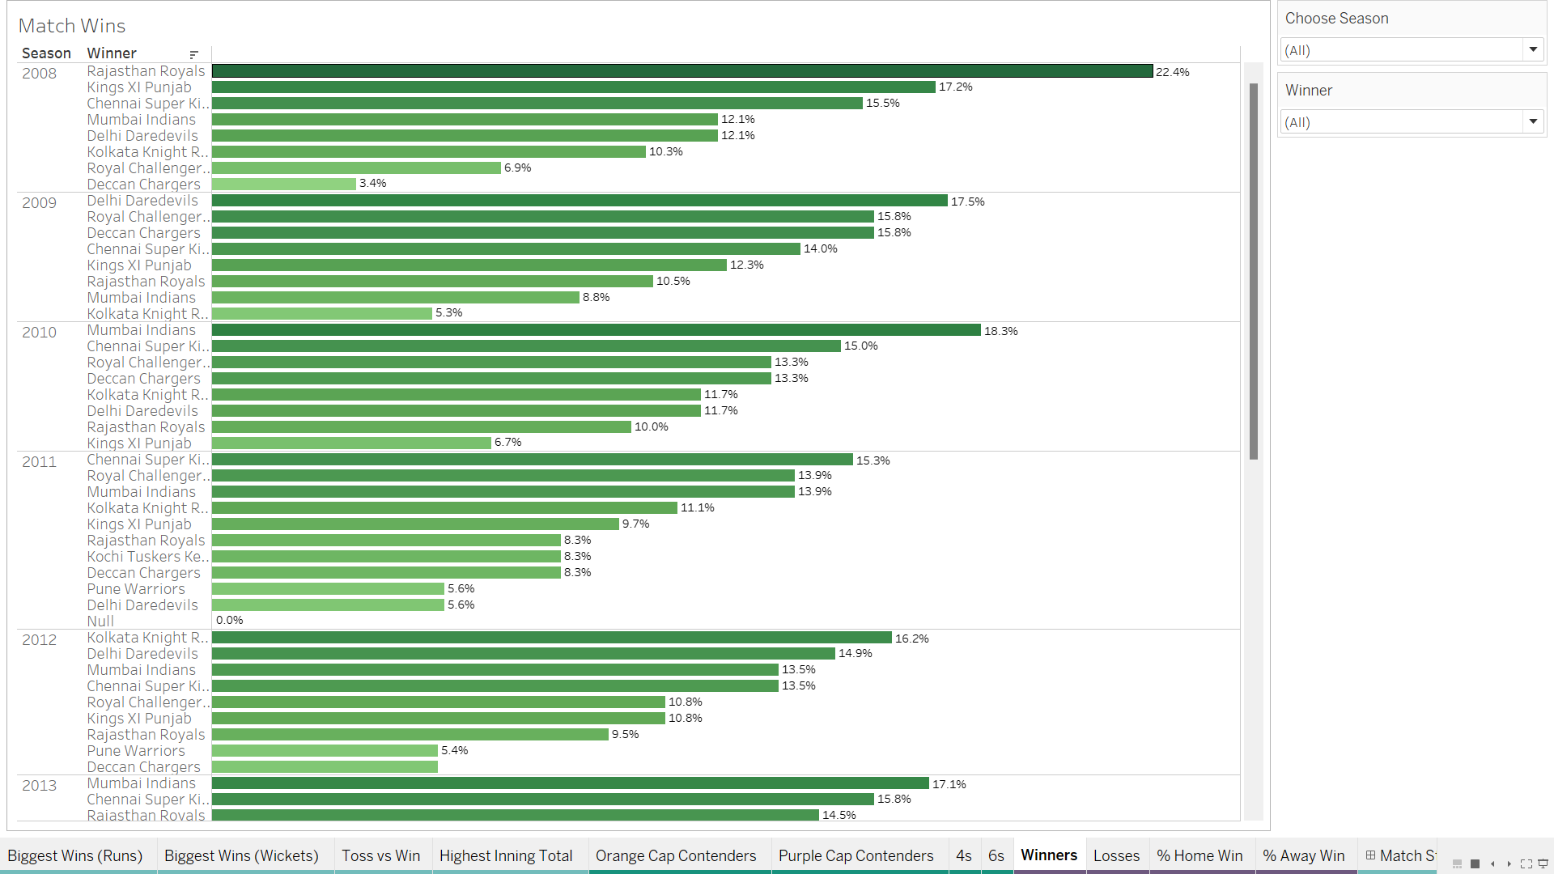
MATCH WINS

Slide 16
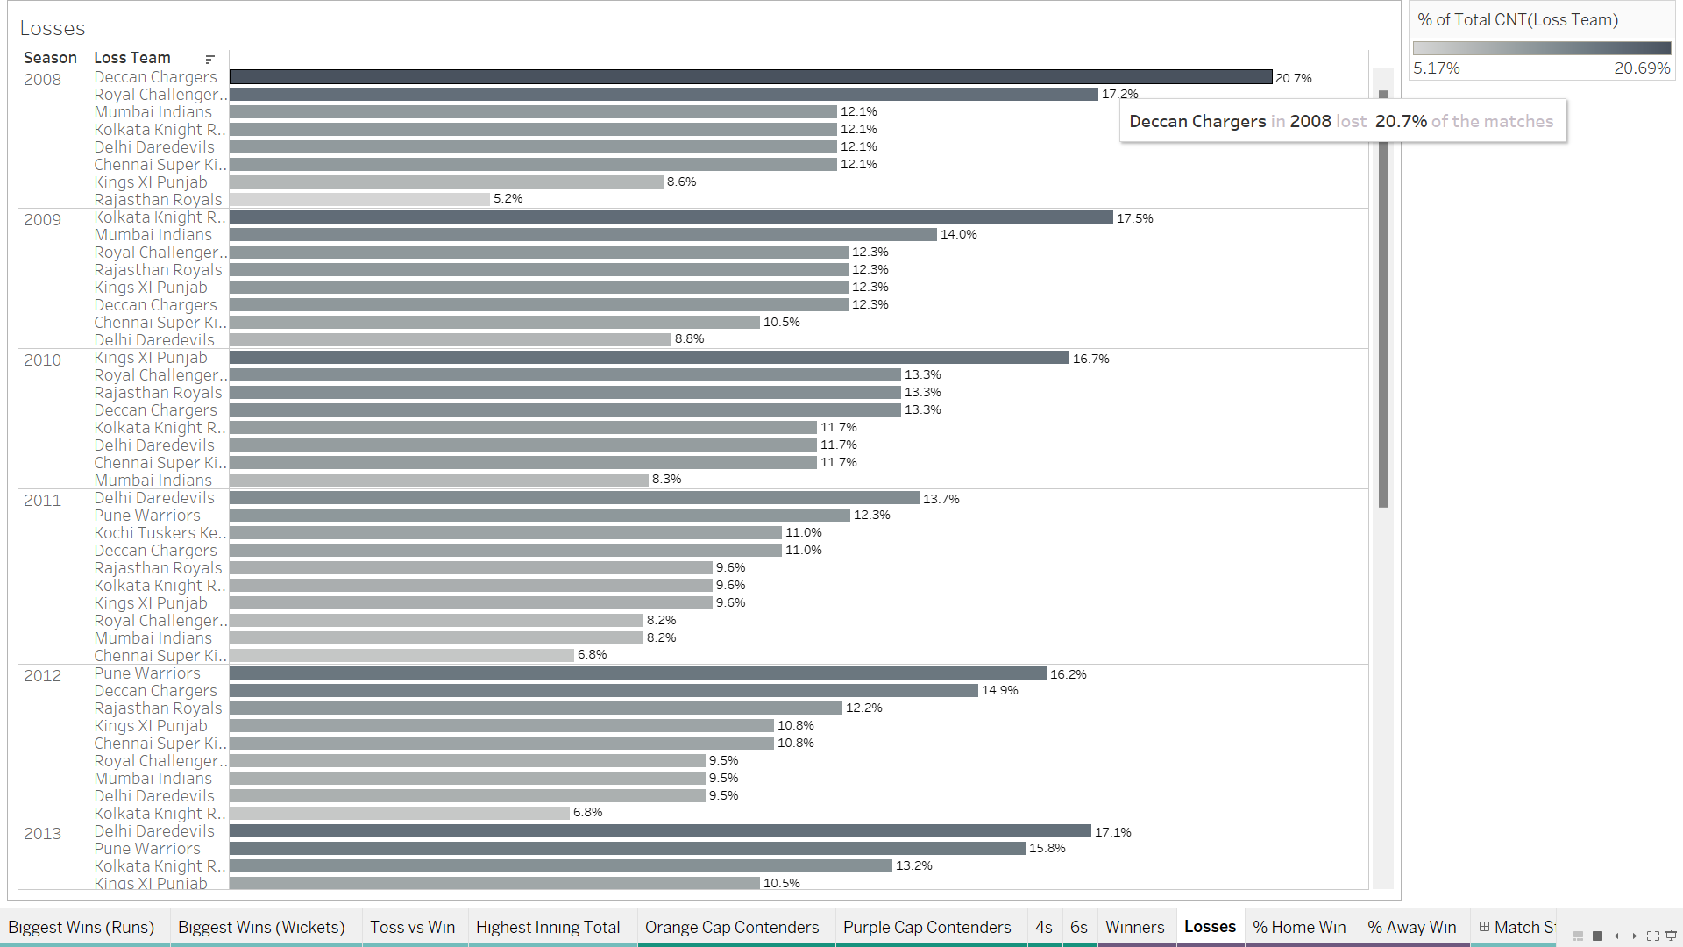
LOSSES

Slide 17
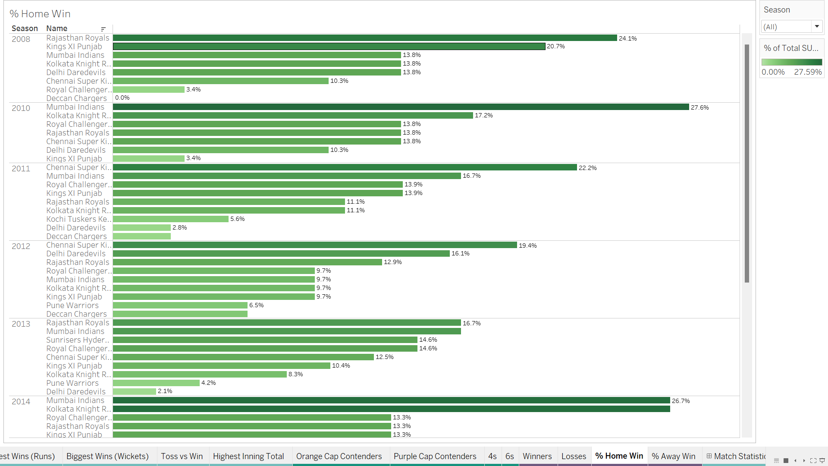
HOME % WIN

Slide 18
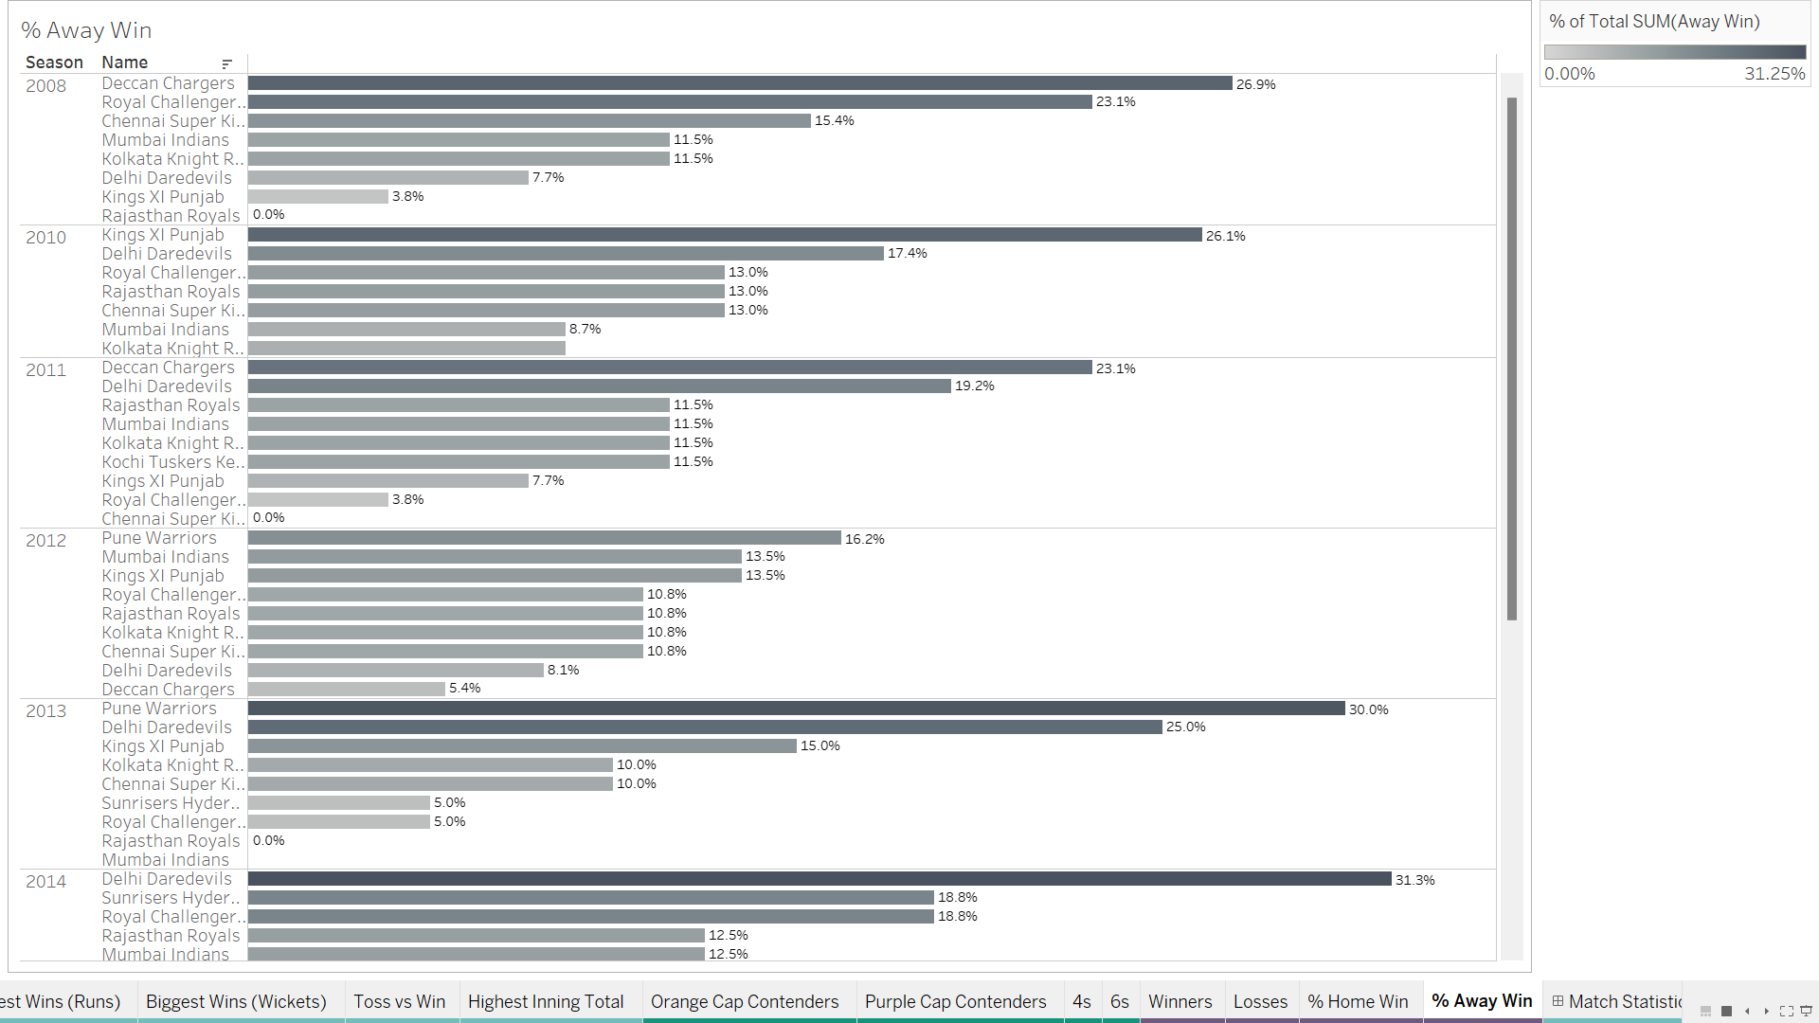
% AWAY WIN

Slide 19
SUMMARY
Even if the players won or lost the toss, most of them chose to do fielding.
Biggest wins among IPL teams throughout the Run: Mumbai Indians, Wickets: Kolkata Knight Riders.
Throughout the seasons, Chennai super kings has the highest totals.
The batsmen who have scored the maximum number of runs and wickets taken in a particular season(2012)- Orange Cap Contenders- CH Gayle (733), Purple Cap Contenders- SL Malinga (25).
Batsmen who hits most no. of fours and sixes in a particular season (2012): Fours- AM Rahanne (73), Sixes- CH Gayle(59)
Overall Season: Fours : G Gambhir (484), Sixes CH Gayle (266).
Year 2013 has overall win % i.e, 69.8% as home, while in the same year, it has lowest win % for away 28.8%.
CH Gayle(RCB) Became a man of the match in year 2011-2012. Moreover, MEK Hussey (CSK) has the highest win Flag score in 2013.

Slide 20
THANK YOU

